Slide 1


February 9, 2026
Psychology Appointment System
SpiRIT: Psychology Appointment System Website
Group 4
Mohammed Ahmad - 754003903
Mohamed Ahmed - 767000238
Nasheel Nadeem - 764000112
Ryan Benson – 421007591

Slide 2
Project Purpose
Streamlining access to mental healthcare services

Slide 3

Key Features
Essential components of our system
User Registration
Psychologist Profiles
Appointment Management
Users can easily register with secure login credentials, ensuring their personal information remains confidential while facilitating seamless access to the appointment system.
Comprehensive profiles provide detailed information about psychologists, including their specialties and availability, enabling users to make informed choices when selecting a mental health professional.
Users can book, reschedule, or cancel appointments effortlessly, with automated notifications keeping them informed of upcoming sessions and reducing the likelihood of missed appointments.

Slide 4
Project Scope
Comprehensive System for Appointment Management
The SpiRIT application will serve as a full-stack web solution, connecting users with psychology professionals while ensuring efficient appointment management and a user-friendly experience.

Slide 5
Development Timeline
Proposal
Design
Development
Testing
Initial project proposal approved and outlined requirements.
Wireframes and UI/UX planning were developed extensively.
Frontend and backend coding began, integrating the database.
Comprehensive testing was conducted to ensure functionality.

Slide 6
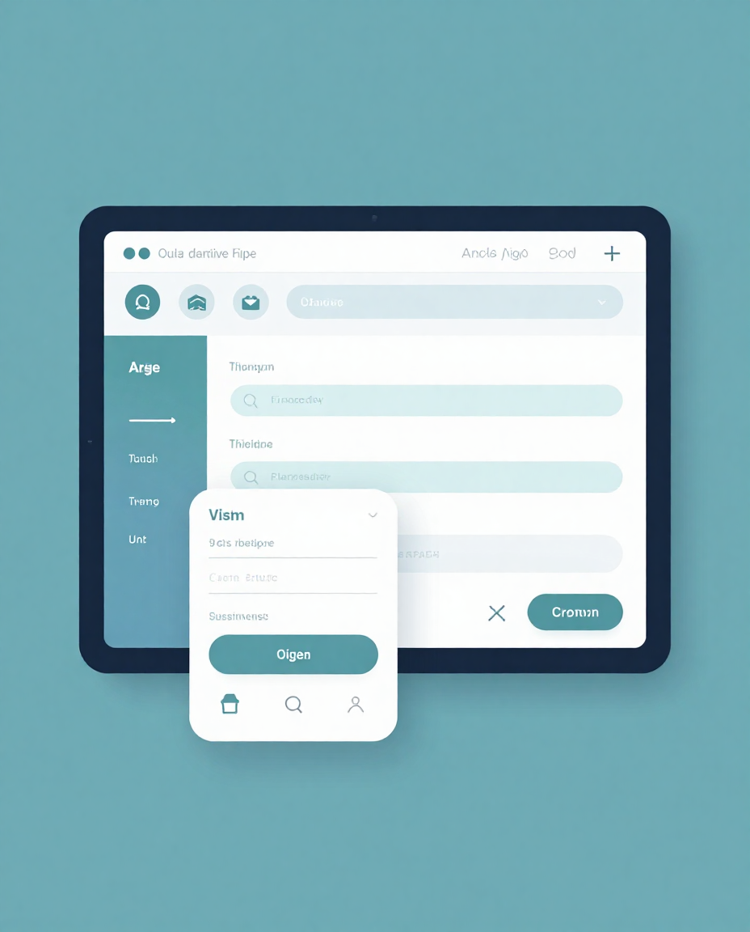
The UX/UI design focuses on usability and accessibility, creating an intuitive interface that reduces user anxiety and fosters a smooth appointment booking experience for all users.

